Slide 1
M. H. Abrams’ A Glossary of Literary Terms
Epic- when a work meets at least the following criteria:
  It is a long verse narrative on a serious subject
  Told in a formal and elevated style
  Centered on a heroic or quasi-divine figure on whose actions depends the fate of a tribe, a nation, or the human race.

Slide 2
Traditionally…
Epics were written versions of what had originally been oral poems about a tribal or national hero during a warlike age.
For example:
  The Iliad & The Odyssey-Greek
  Beowulf- Anglo-Saxon
  Chanson de Roland- French
  Poema del Cid- Spanish

Slide 3
According to Homer, an epic has the following features:
The hero is a figure of great national or cosmic importance.
The setting of the poem is ample in scale. (Odysseus wanders all over the Mediterranean basin and descends into the Underworld)
The action involves superhuman deeds in battle or along, arduous, and dangerous journey accomplished.
In these great actions the gods and other supernatural beings take an interest or an active part.
An epic poem is a ceremonial performance, and is narrated in ceremonial style

Slide 4
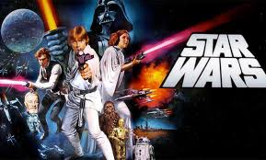
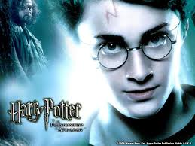
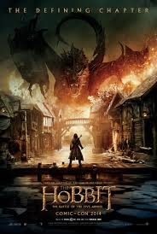
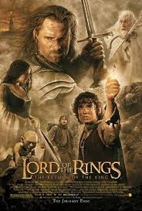
Can you think of other epics?

Slide 5
The Epic Hero
Epic Hero
Superhuman
During quest, goes through trials and tribulations in order to achieve his goal
Villains try to keep the hero from his quest
On a quest for something of great value
Has a tragic flaw
Of mixed divine and human birth

Slide 6

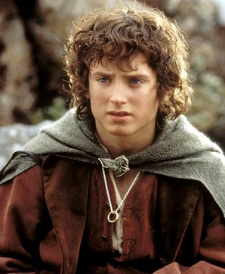
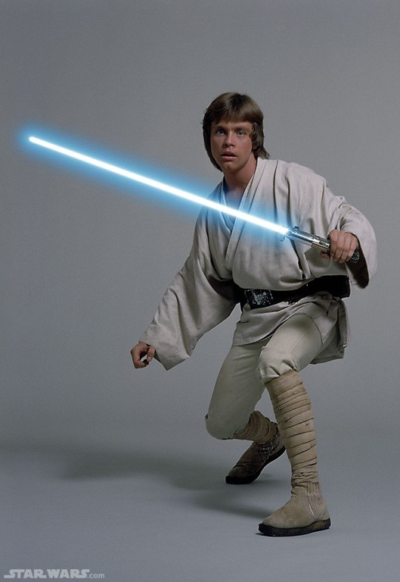
Epic Hero
Represents values of a culture

Slide 7
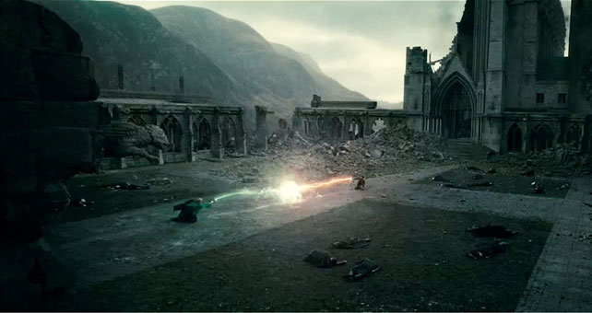
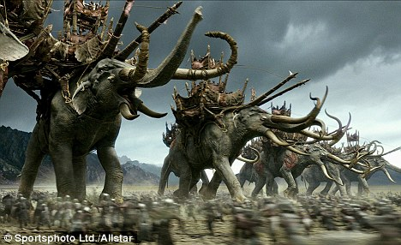
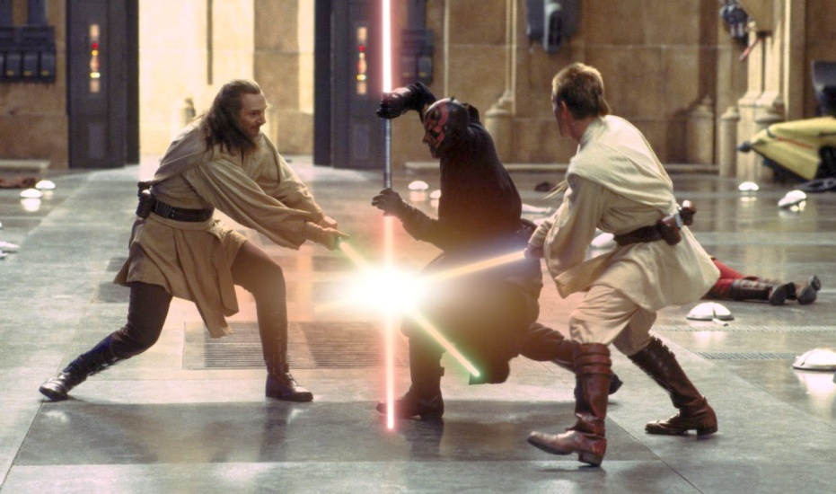
Epic Hero
Undertakes a difficult journey or quest

Slide 8
Epic Hero
Has an unusual origin
“Luke…I am your father.”
“You’re a wizard Harry!”
“Even the smallest person can change the course of the future.”

Slide 9
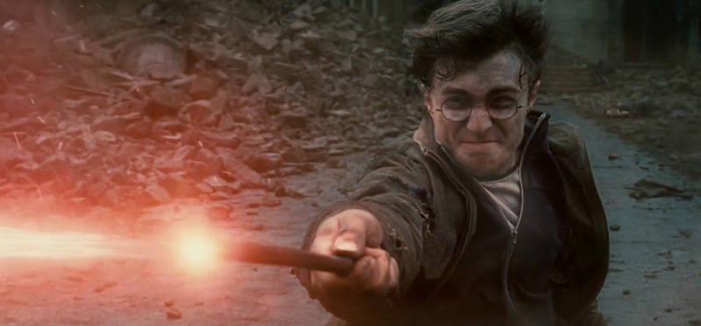
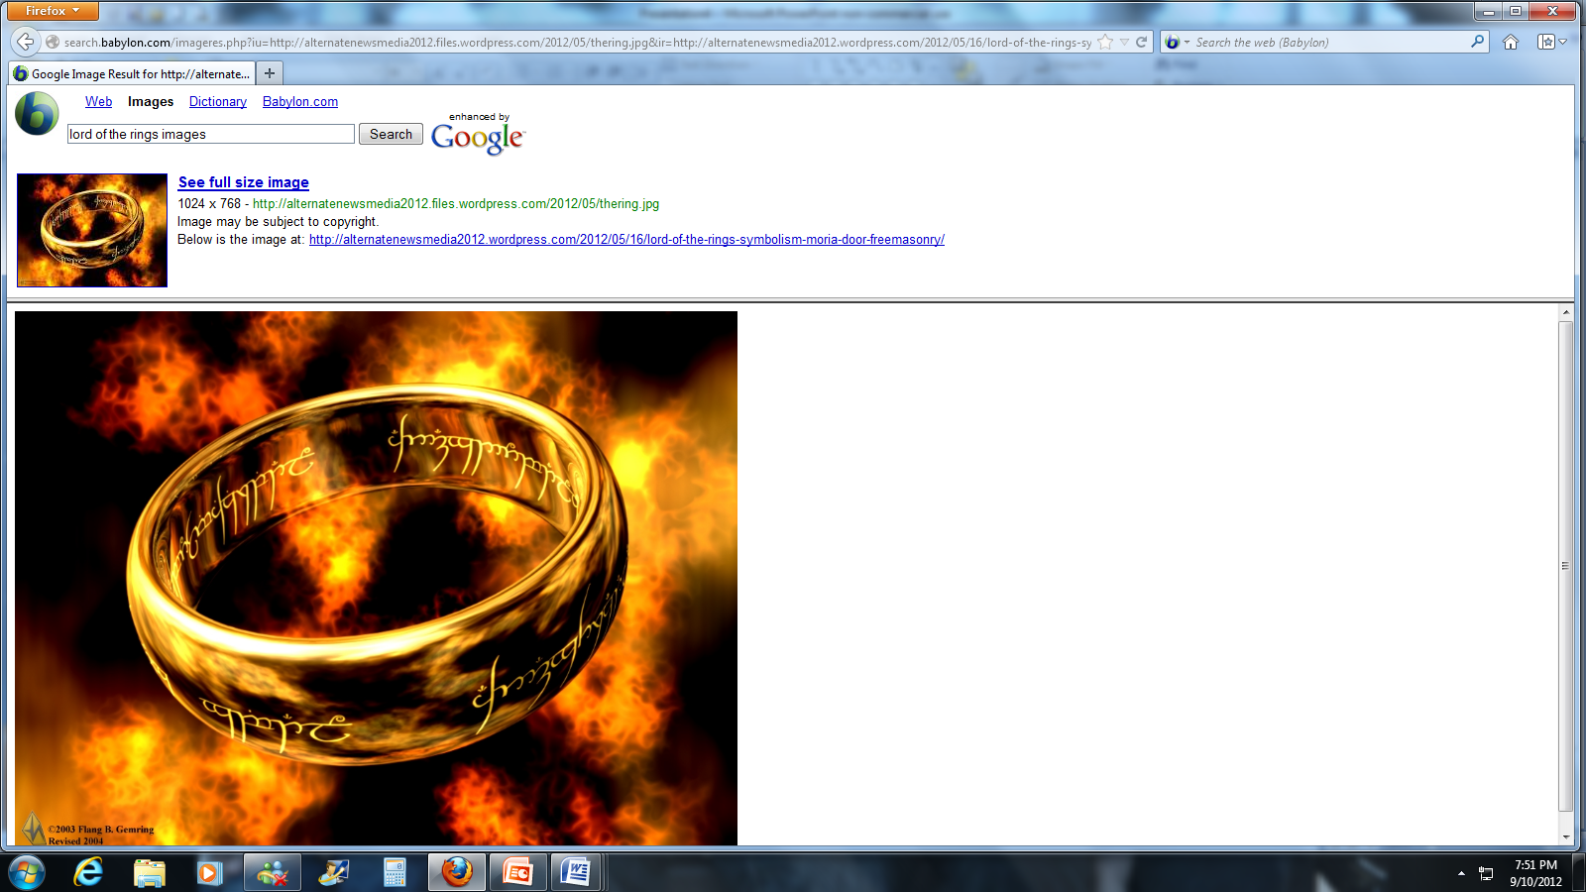
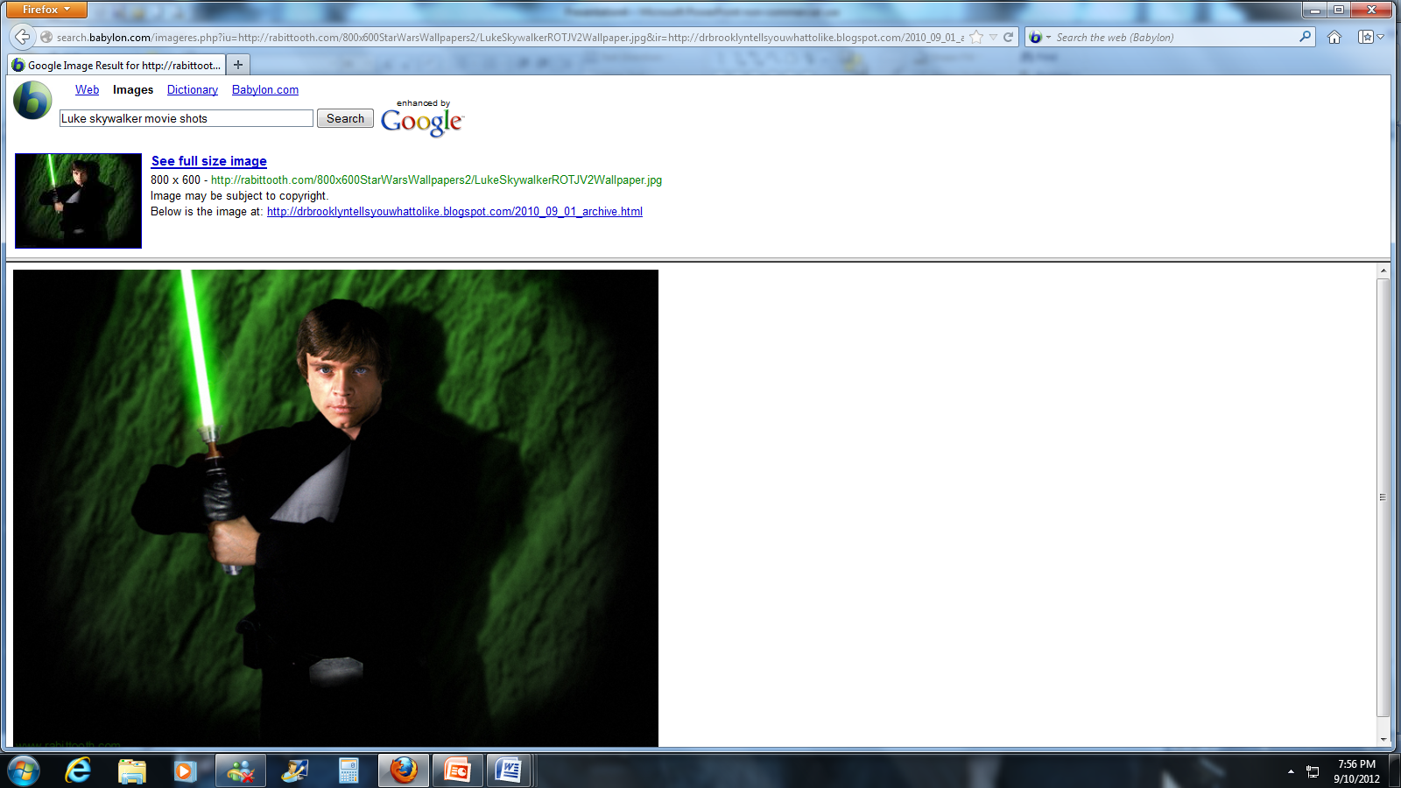
Epic Hero
Has a special ability or weapon

Slide 10
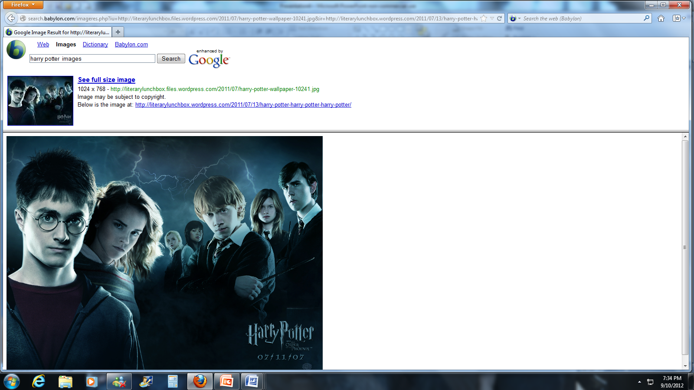
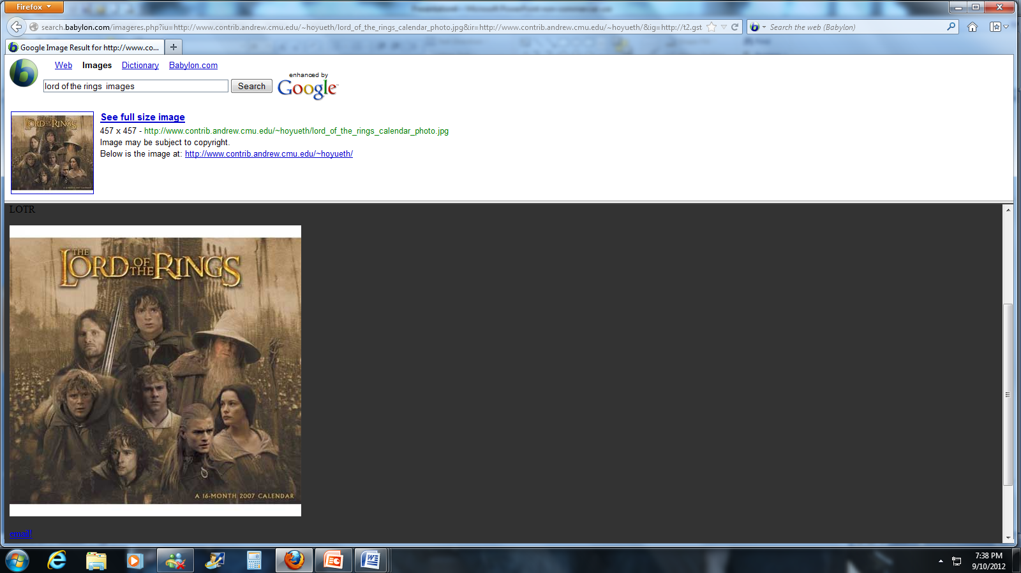
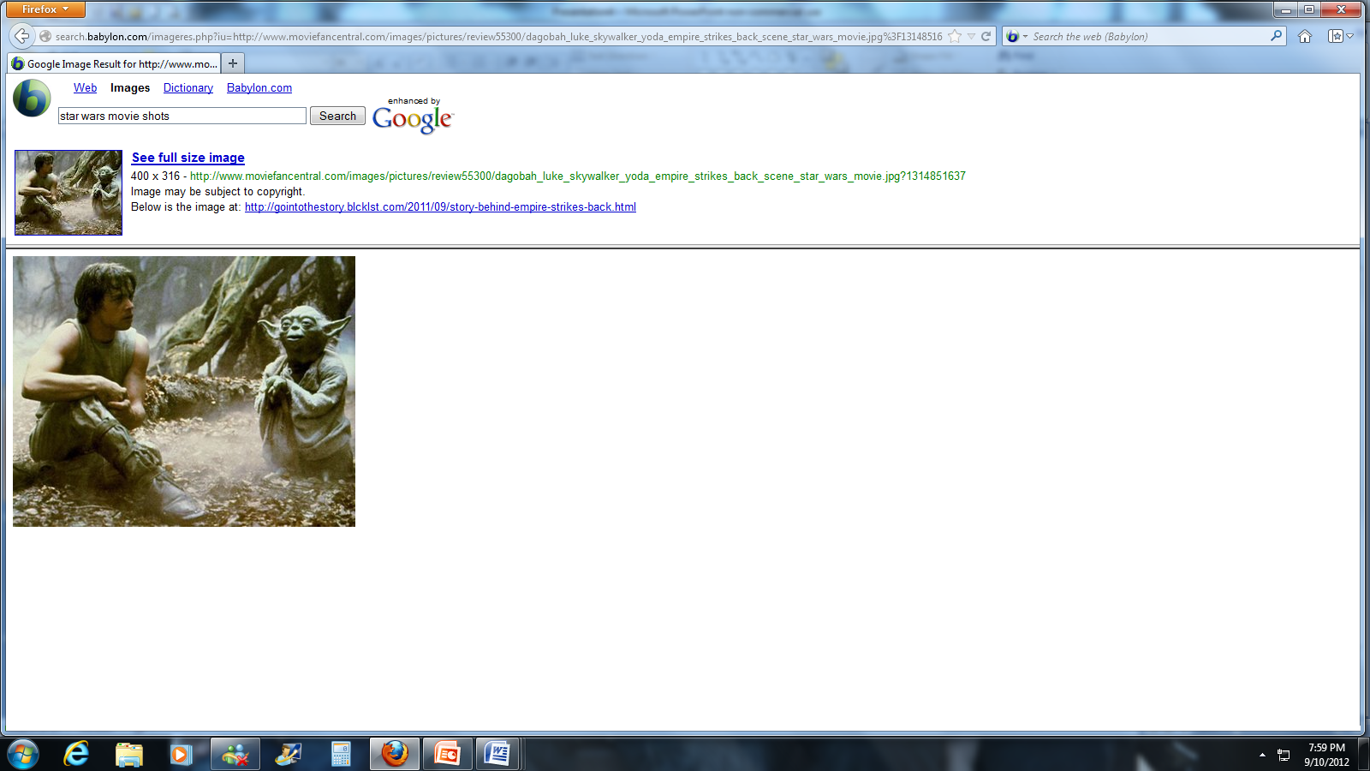
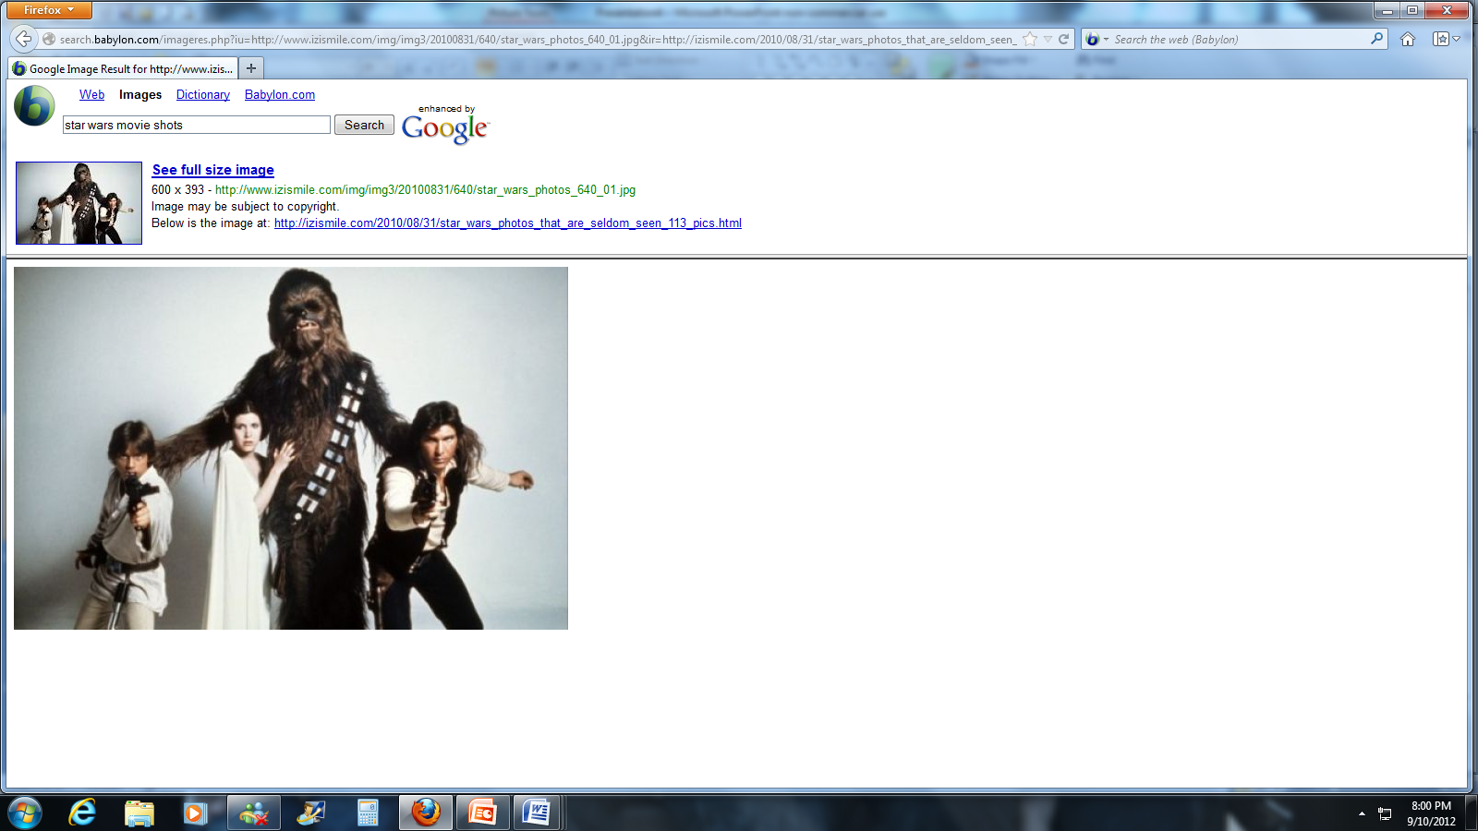
Epic Hero
Has friends and advisors to help him along the way

Slide 11
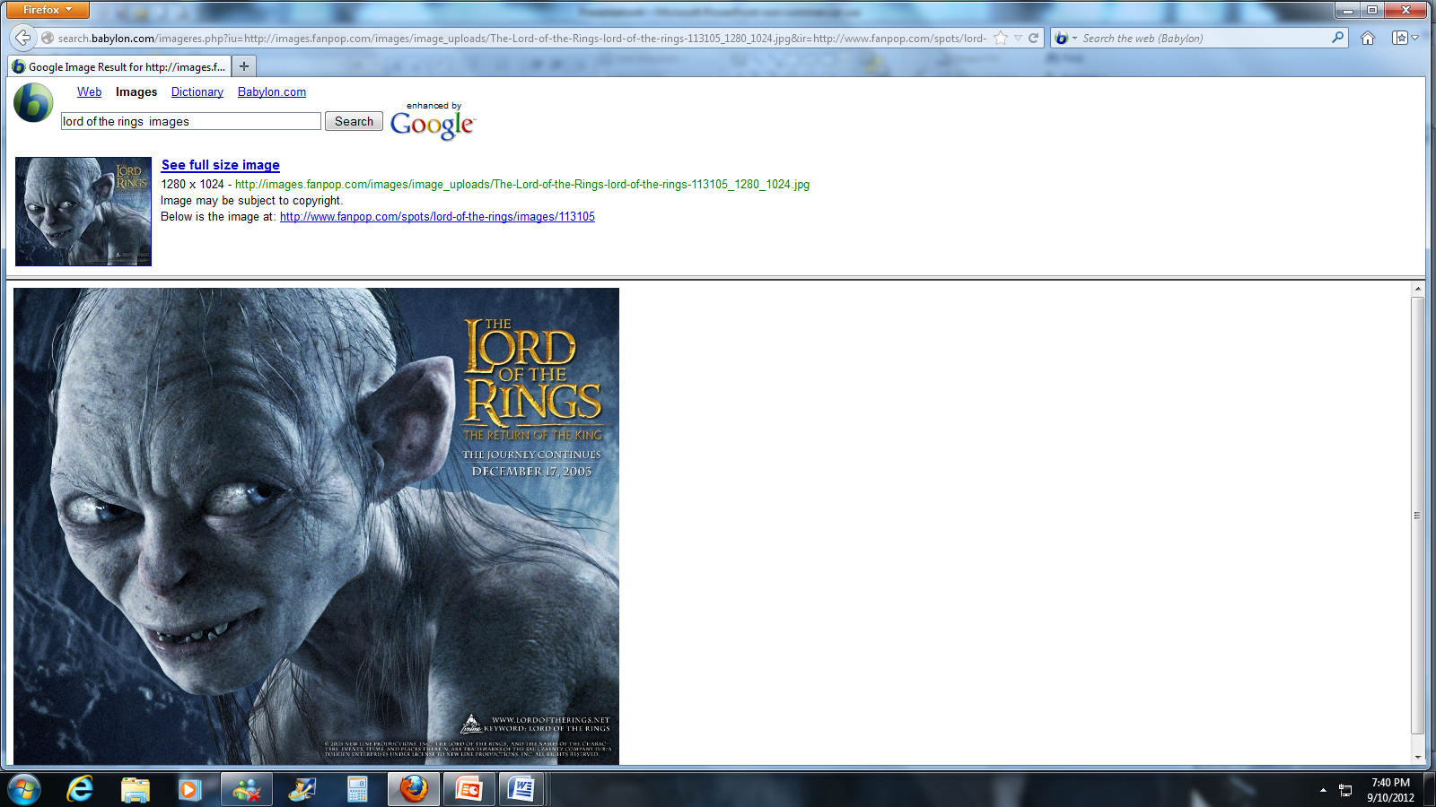
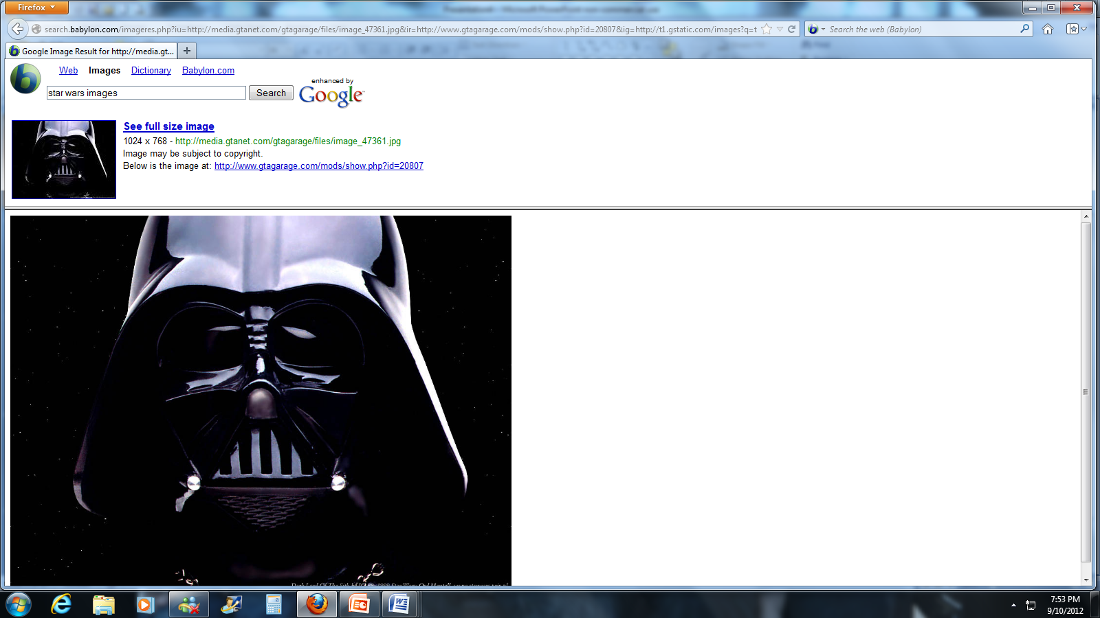
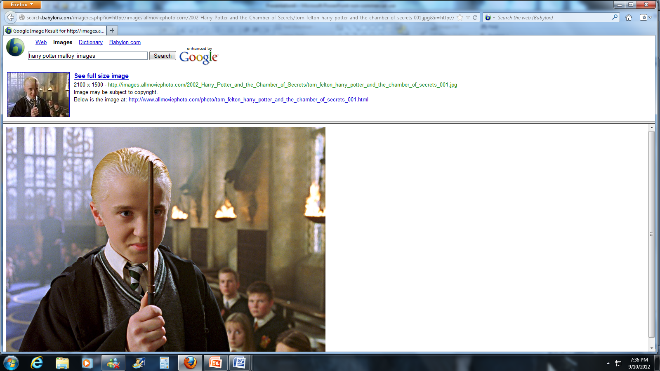
Epic Heroes
Has a foil (antagonist who is both similar and different to the hero at the same time)

Slide 12
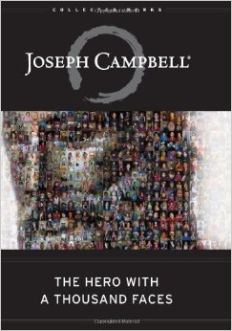
The Hero’s Journey
Joseph Campbell’s greatest work The Hero With A Thousand Faces outlines the pattern all heroes (ancient to contemporary) go through in order to become a hero.
He breaks down the journey into three key steps:
1. The Departure
2. The Initiation
3. The Return
Each step has their own milestones that are important to know….

Slide 13
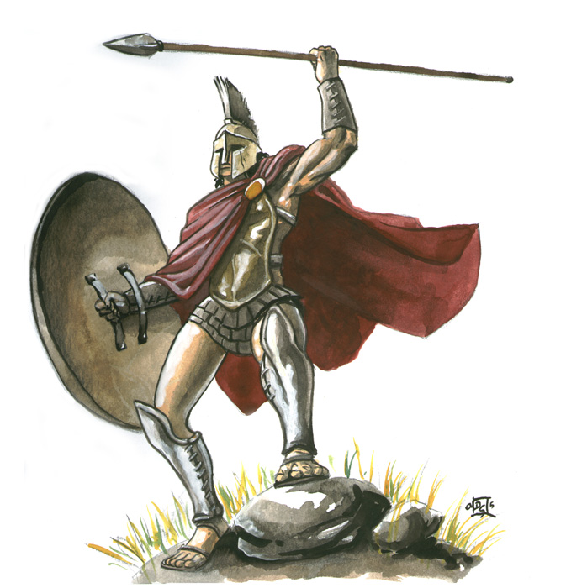
The Hero’s Journey
Departure:
    The Call to Adventure
    Refusal of the Call
    Supernatural Aid
    The Crossing of the Threshold
    The Belly of the Whale

Slide 14
The Hero’s Journey
2. Initiation
    The Road of Trials
    The Meeting with the Goddess
    Woman as the Temptress
    Atonement with the Father
    Apotheosis
    The Ultimate Boon

Slide 15
The Hero’s Journey
Return:
    Refusal of the Return
    The Magic Flight
    Rescue from Without
    The Crossing of the Return Threshold
    Master of the Two Worlds
    The Freedom to Live

Slide 16
Epic Conventions
Invocation of the Muse: a plea to the Muse, goddess of poetry, for inspiration
Noble subject: Subject of importance
Apostrophe: turning aside from telling the story to comment; address to an absent or imaginary person
Homeric/Epic Simile: long similes that compare extreme adventure with everyday events, usually many lines long

Slide 17
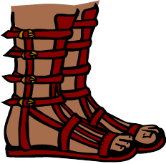
Epic Conventions
In medias res: in the middle of things/action
Action on three planes: heavens, earth, & underworld
Epithet: nickname
Deus ex machina: intervention by the gods/machinery
Inflated forms of address: long speeches
Heroes: embody the values of civilization and what the culture is
Catalogues: long lists
Processes: instruction manuals

Slide 18
Vocabulary
Myths: traditional stories rooted in particular cultures that explain religious beliefs/values and explain natural occurrences
Archetype: story, character, topic, or theme that represents a familiar pattern repeated throughout literature

Slide 19
Okay…
Everything you need to know in a nutshell

Slide 20
Epic Literary Terms
(no pun intended)
The Epic
Long narrative poem about the deeds of an epic hero
Epic Hero
The central figure of an epic
Actions are inspiring or noble
Epic Simile/Homeric Simile
An ELABORATE comparison of unlike subjects
Tragic Flaw
A weakness in the hero’s character
Symbolism
Frequent use of words, places, characters, or objects that mean something beyond what they are on a literal level
Irony
Indicating through character or plot development an intention or attitude opposite to that which is actually stated

Slide 21
Epic Literary Terms
(no pun intended)
Imagery
Foreshadowing
Hints of future events in a piece of literature
Flashback
Writers’ technique in which the author interrupts the plot of the story to recreate an incident of an earlier time (goes back in time; like giving the reader a memory).
In Media res
The classical tradition of opening an epic not in the chronological point at which the sequence of events would start, but rather at the midway point of the story.
The "mental pictures" that readers experience with a passage of literature
Often appeals to senses

