Slide 1
The Odyssey
And the Epic Tradition

Slide 2
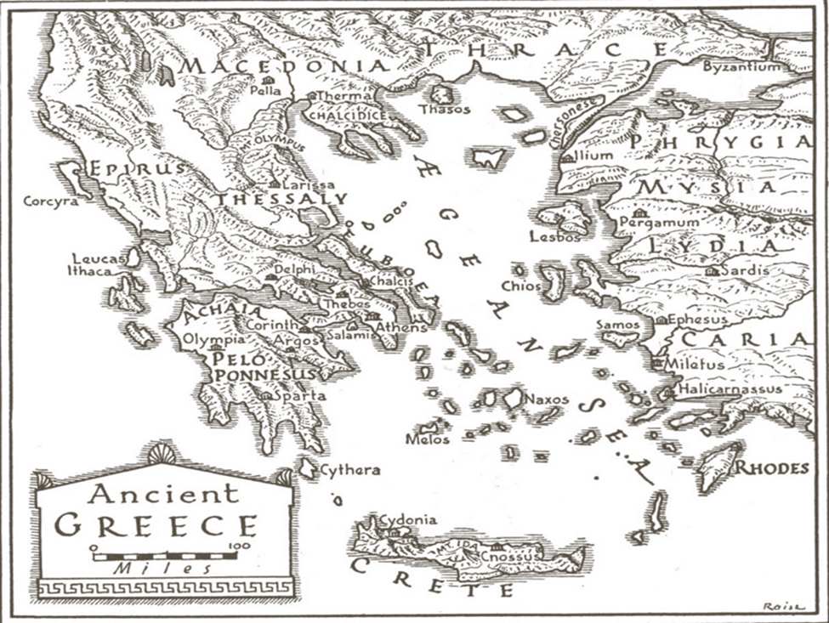
Before history books….
Ancient Greeks turned to poets to hear stories of the past.
These poets traveled from city to city singing or reciting long poetic epics in front of crowds
These were partly memorized and partly improvised

Slide 3
2 Epic Poems written in 725 B.C. by Homer, a blind poet
The Iliad
First written record of Greece
Describes the events of 51 days during the last year of the war when Achilles kills Hector
The Odyssey
Describes the 10-year journey of Odysseus as he tries to go home to Ithaca after the Trojan War
He and his men face monsters, giants, cannibals, temptation, and death

Slide 4
What do you need to know about Homer?
Minstrel/Singer from the island Chios
Homer was a Rapsode or singer of tales.
All historians/entertainers of Homer’s time did not write their stories/facts down.
This Homer
Not This
Homer…

Slide 5
What do you need to know about The Odyssey?
Sequel to the Iliad (900 and 700 BC)
The Iliad focuses on the days toward the end of the Trojan War (mid 1200s BC)
The Odyssey focuses on one of the soldiers who fought in the Trojan War returning home 19 years after the war—Odysseus
The Iliad and the Odyssey together were considered sacred to the Greeks—much like the Bible to many people today.
Neither books were originally written down.
Both were originally recited orally.

Slide 6
What do you need to know about the Trojan War?
Spartan King Menelaus’ wife Helen (the face that launched a thousand ships) left him for the young Prince Paris of Troy.
Greeks attacked Troy
Agamemnon, brother of Menelaus, led the siege.
Odysseus (main character in the Odyssey) was another hero of the war.
Odysseus was known not only for being a strong hero, but also for being a wise/smart hero.
Another hero, Achilles, died in the final year of the war.
Greek forces were victorious!
Hi, Brad!

Slide 7
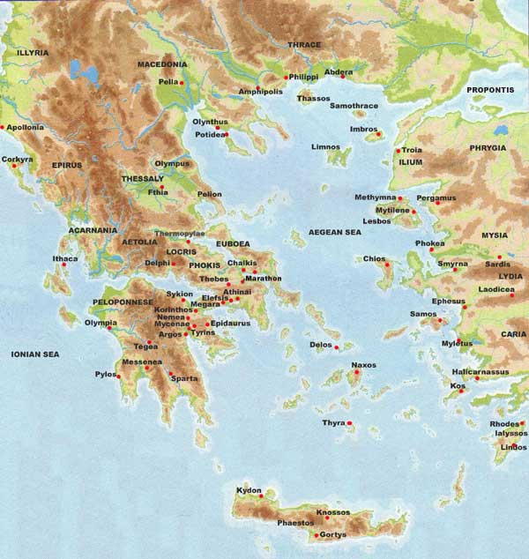
Where are we?

Slide 8
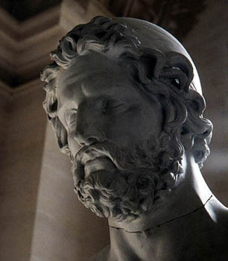
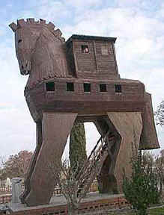
Odysseus: Hero of the Odyssey
Wife: Penelope
Son: Telemachus
Great soldier of the war
Originally tried to get out of going to the war—pretended he was crazy
Came up with the wooden-horse trick that lead to Troy’s collapse.
The Odyssey is the account of Odysseus’ journey home after the war.
He is the king of Ithaca
His wife is Penelope; his son is Telemachus
His greatest supporter is Athena
He was drafted to the war and was the brains behind the Trojan Horse
Now that the war is over, it is time for him to return to Ithaca
Here is where our adventure begins…

Slide 9
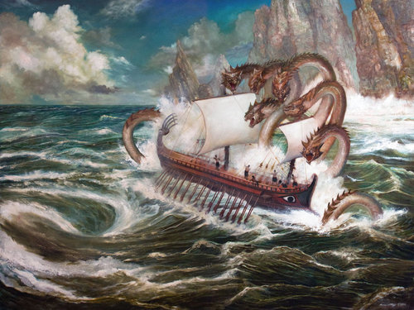
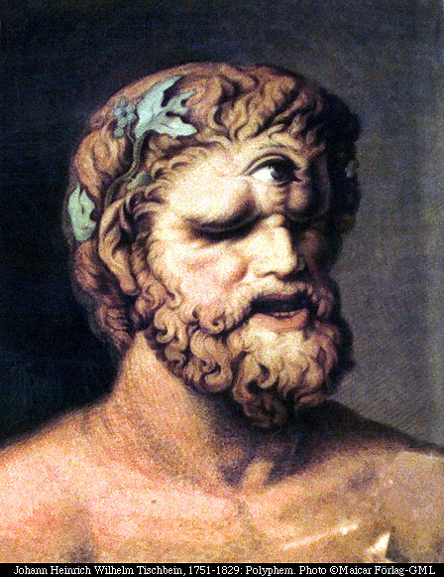
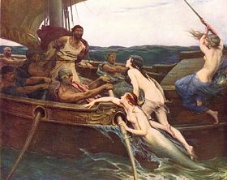
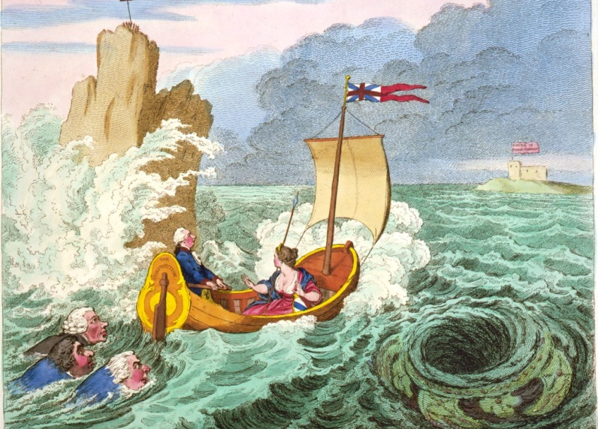
He will face many creatures and gods that will make his journey difficult

Slide 10
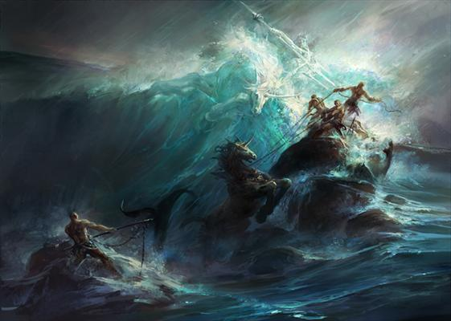
His biggest problem is that he has made an enemy of the sea god, Poseidon
He is traveling with hundreds of his men yet he will be the only survivor

Slide 12
Awaiting him in Ithaca… the beginning of the story.
He has been gone 20 years
His son, who was only a newborn when he left, is overrun by over 100 suitors that want to marry his mother
They are eating through his livestock, ordering around the servants, and refusing to leave
Athena arrives in disguise and convinces him to go look for information about his father

Slide 13
Three Major Plot Strands
Story in Ithaca about Odysseus’ wife and son as they await his return (called the Telemachy)
Tale of Odysseus’ wanderings during the ten years following the Trojan War
Merging of the strands when Odysseus returns to Ithaca and joins forces with his son, Telemachus, to destroy their enemies

